Slide 1
Time Series Forecasting (with Python)
A Review of Jason Brownlee’s Intro

Slide 2
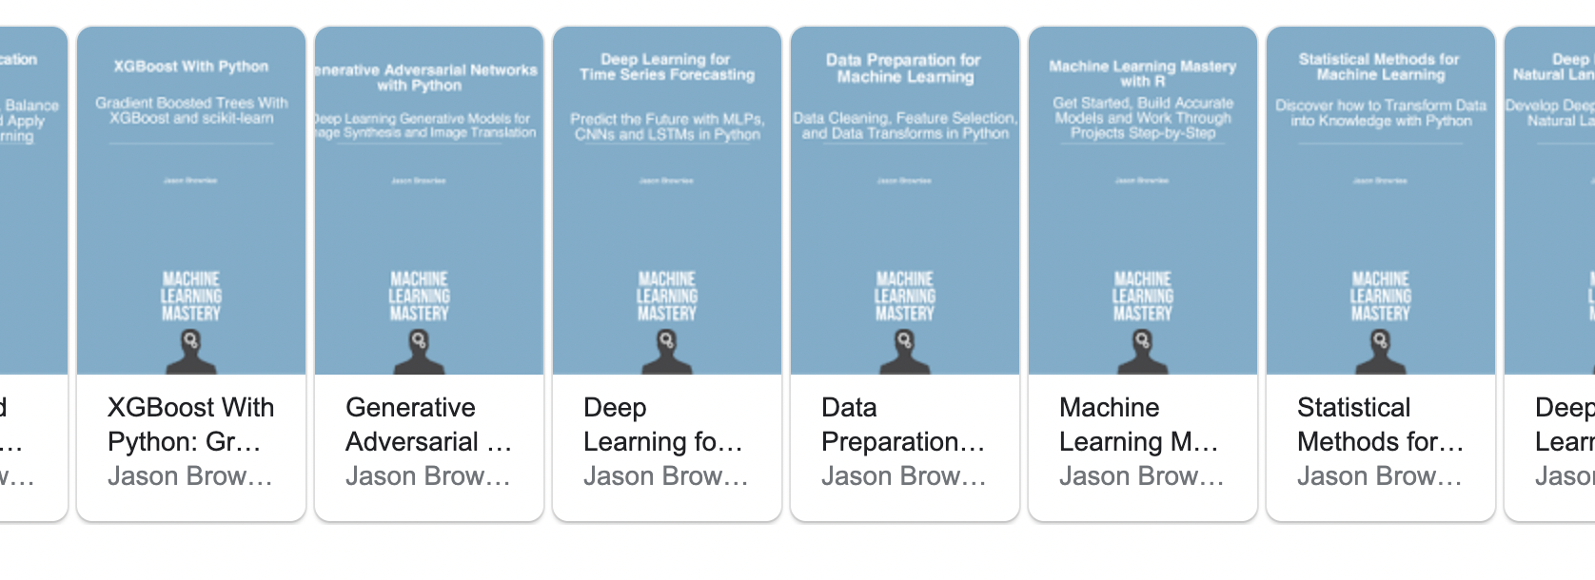

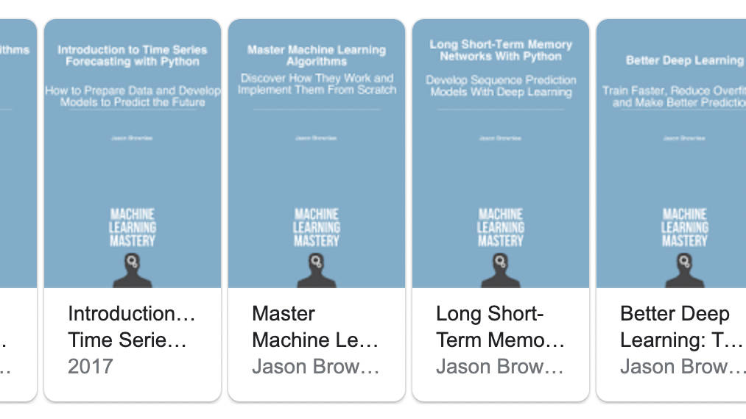
Jason Brownlee
Founder of SuperFast Python & Machine Learning Mastery
Published more than 20 books

Slide 3
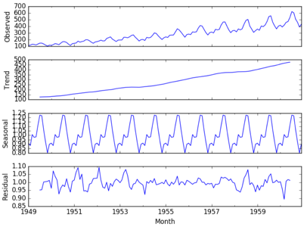
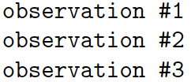
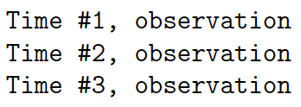
What is Time Series Forecasting?
Describing vs. Predicting
Four Components
Normal ML Data Set vs. Time Series

Slide 4
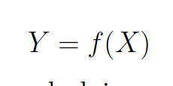
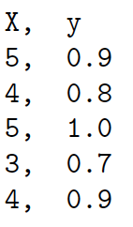
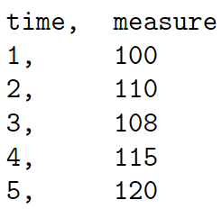
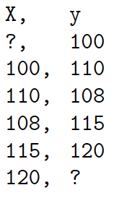
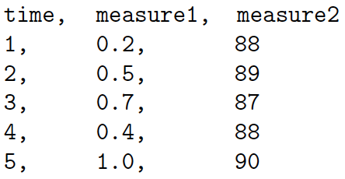
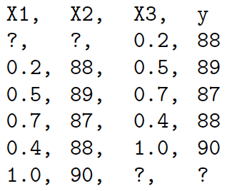
Time Series & Supervised Learning (SL)
Univariate
A small SL Data Set
A Time Series Data Set
A Time Series Converted to a ML SL Data Set
Multivariate

Slide 5
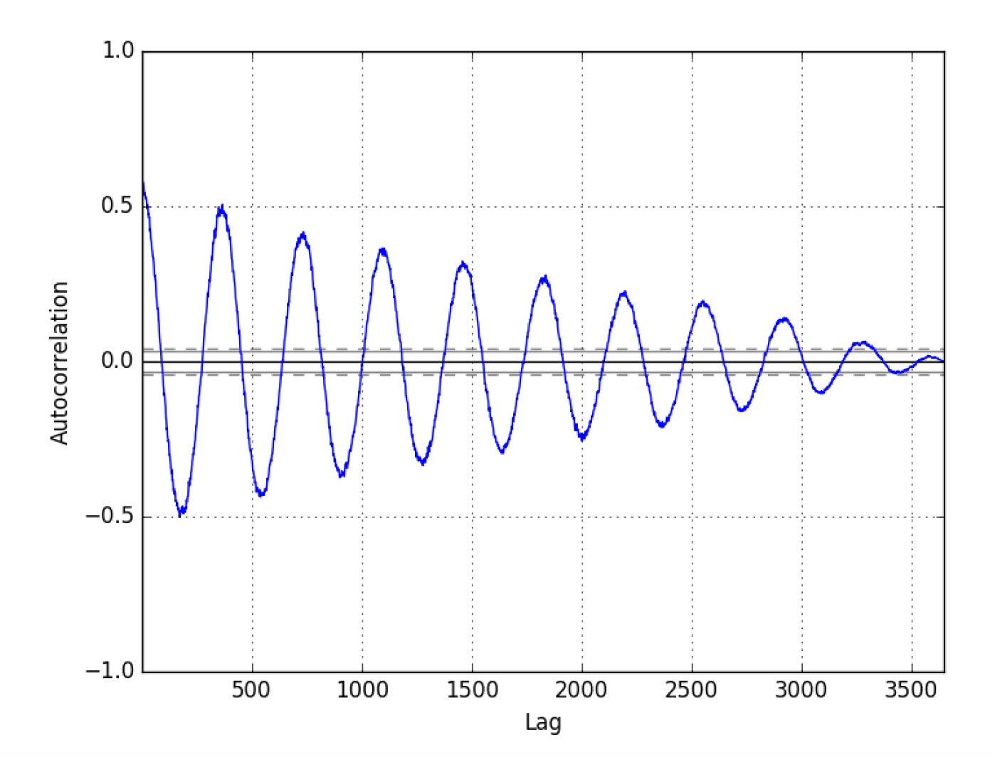
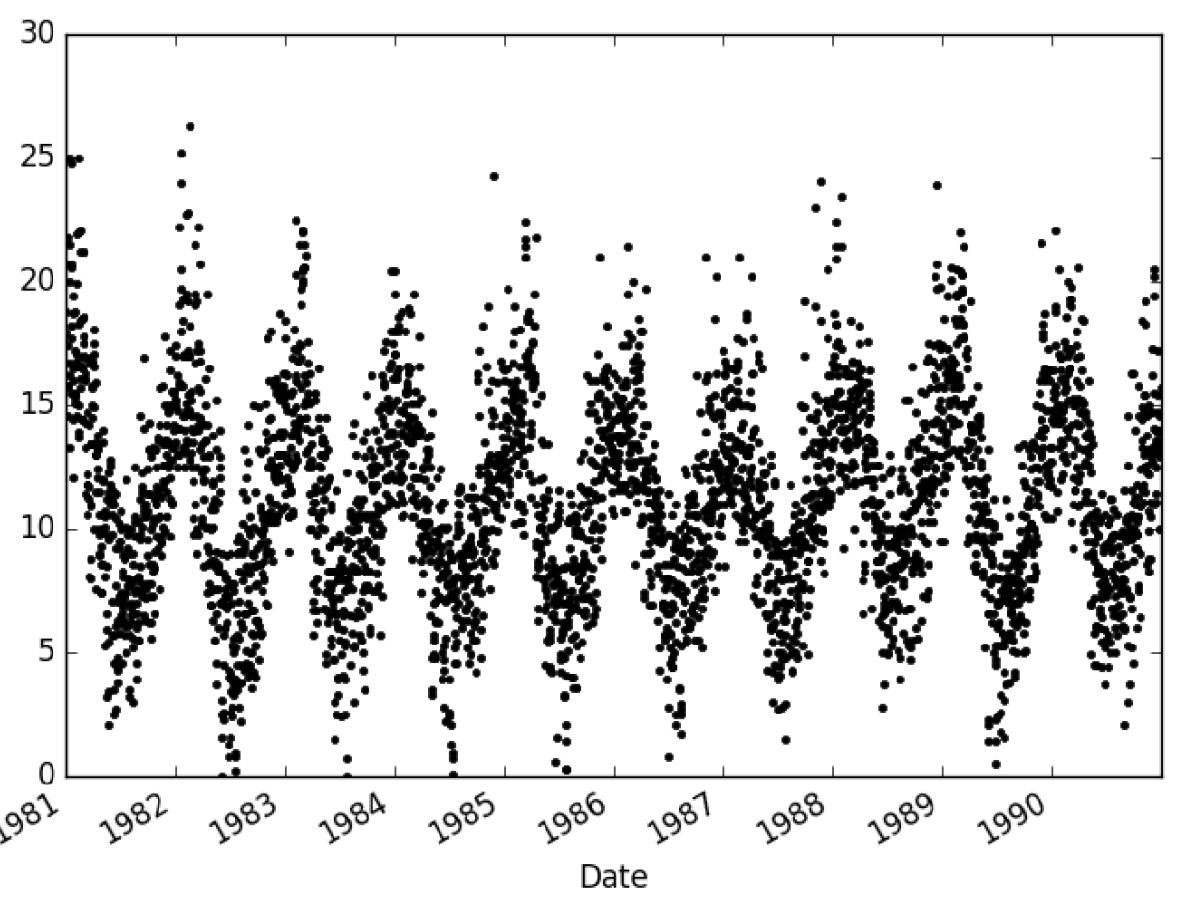
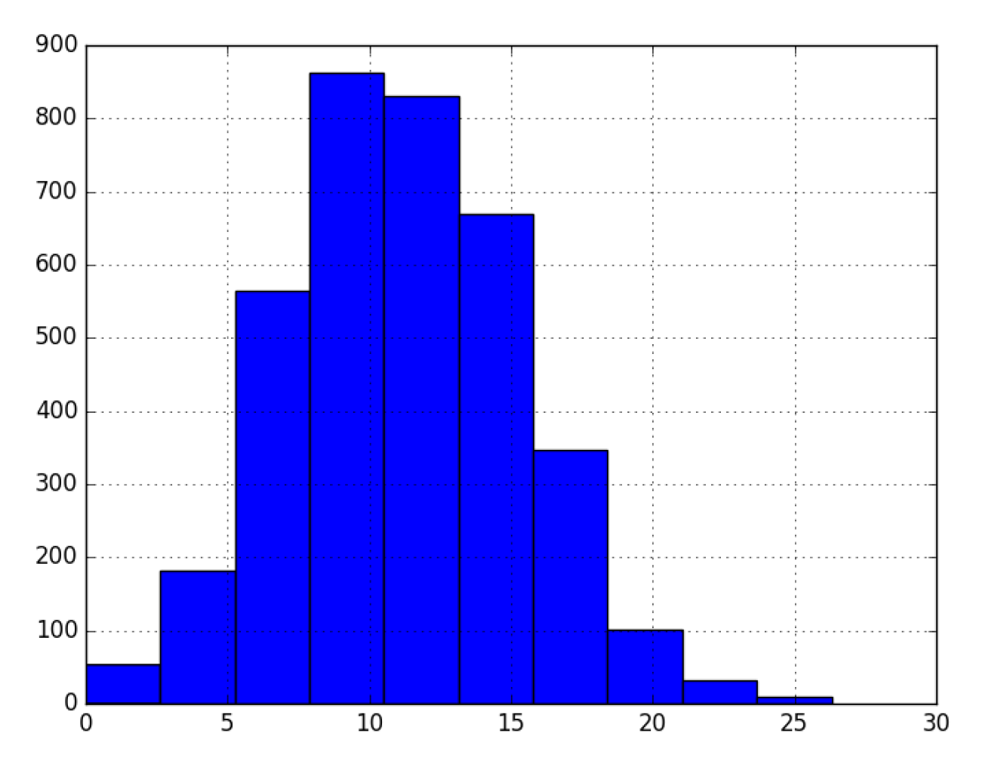
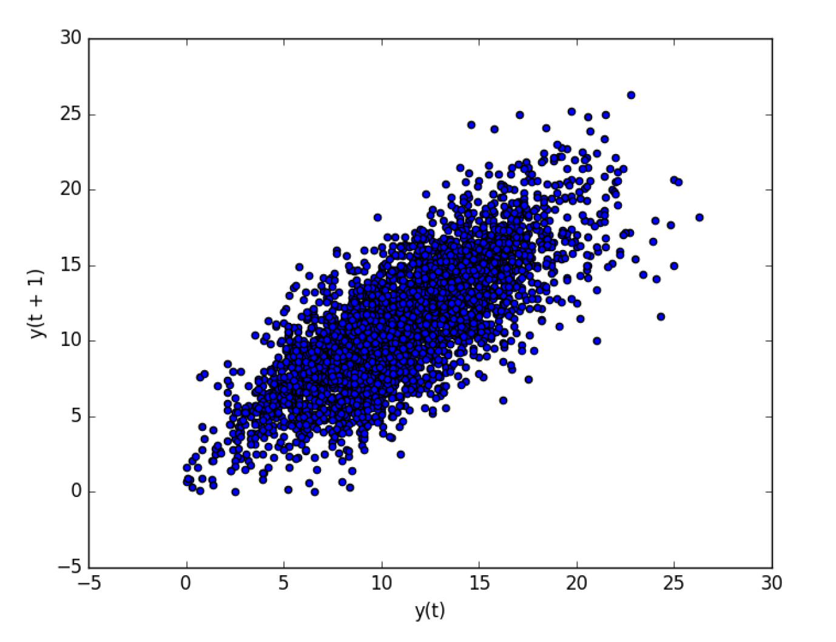
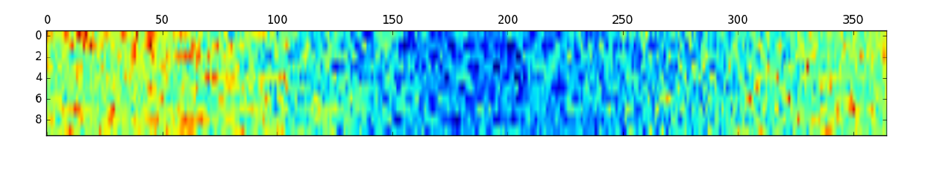
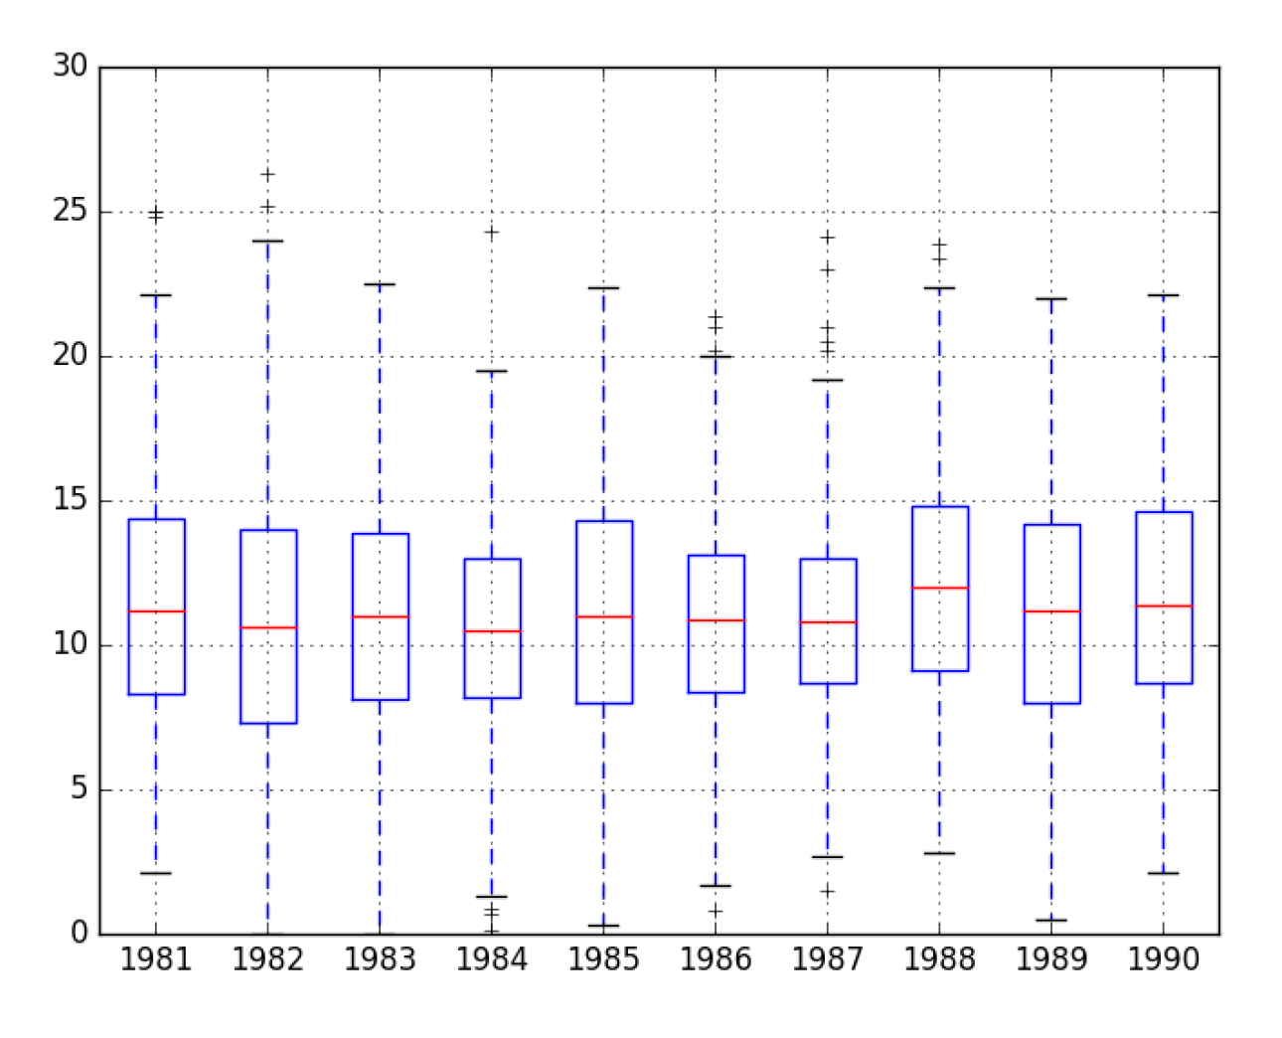
Data Visualization

Slide 6
Resampling and Interpolation
About changing the frequency of your observation
Upsampling: increase frequency of observations
Ex: Going from monthly observations to daily observation
Question of how to fill in the missing values
Usually use a line or a polynomial to connect two points
Downsampling: decrease frequency of observation
Same idea as above, but now we are going from monthly measurements, to quarterly observations
Usually use means to get the summarized data

Slide 7
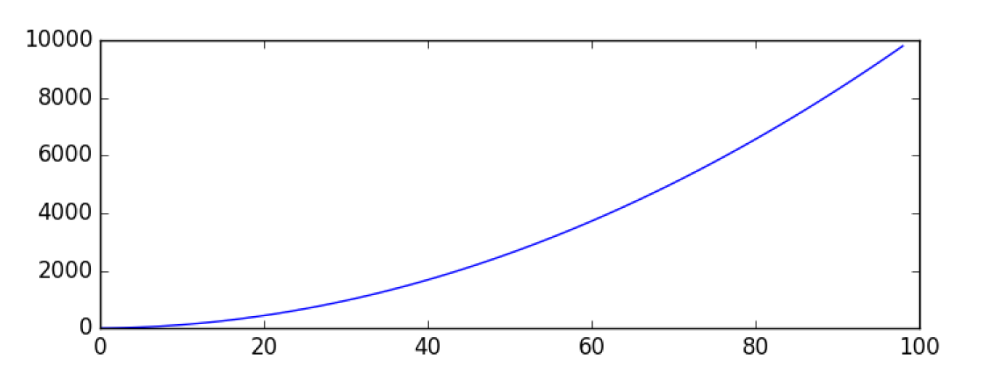
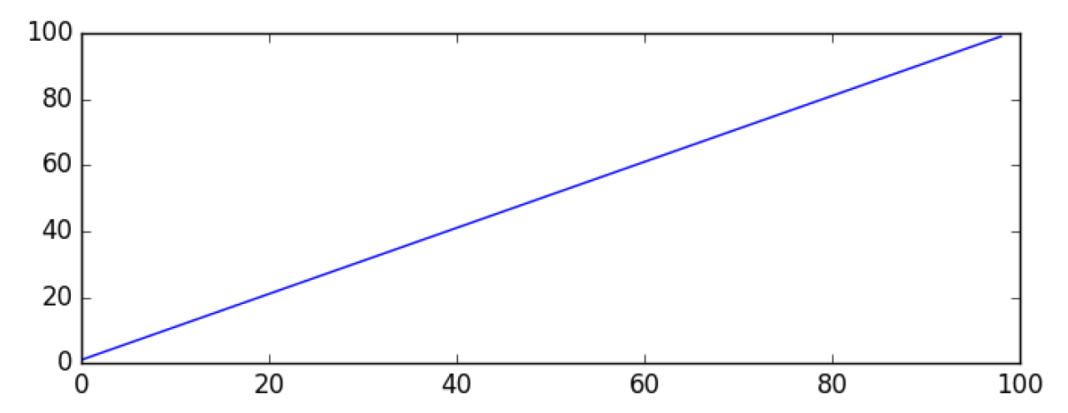
Power Transforms
Ex: Square Root Power Transform
Data transforms are intended to remove noise and improve the signal in time series forecasting.
Square Root Transform:
A time series that has a quadratic growth trend can be made linear by taking the square root.
Log Transform:
Time series with an exponential distribution can be made linear by taking the logarithm of the values.
Box-Cox Transform:
The Box-Cox transform is a configurable data transform method that supports both square root and log transform, as well as a suite of related transforms.
it can be configured to evaluate a suite of transforms automatically and select the best fit.
See boxcox() function
Notice the quadratic trend.
By taking the square root of every term in the original time series, we can remove the trend

Slide 8
Moving Average Smoothing
a technique applied to time series to remove the fine-grained variation between time steps (removes noise)
Calculating a moving average involves creating a new series where the values are comprised of the average of raw observations in the original time series
Two different techniques:
Centered moving average: center ma(t) = mean(obs(t - 1); obs(t); obs(t + 1))
Trailing moving average: trail ma(t) = mean(obs(t - 2); obs(t - 1); obs(t))
Use Python’s rolling(window_size) function to achieve this

Slide 9
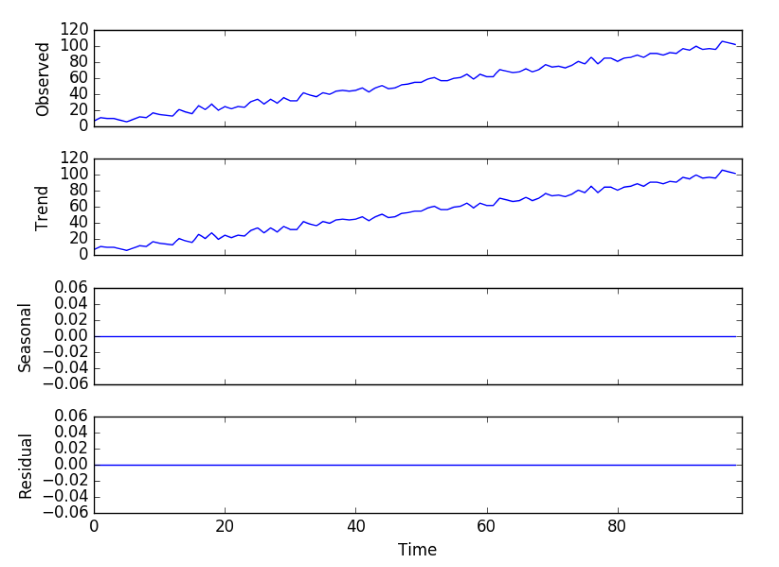

Time Series Components
Systematic: Level, Trend, Seasonality
Non-Systematic: Noise
y(t) = Level + Trend + Seasonality + Noise (additive)
y(t) = Level $×$ Trend $×$ Seasonality $×$ Noise (multiplicative)
Statsmodels library provides automated decomposition tools

Slide 10
Noise
y(t) = signal(t) + noise(t)
Signal(t) = trend + seasonality + level
A time series is white noise if the observations are independent and identically distributed with a mean of zero. => complete random error
Filtering on horizontal and vertical scale

Slide 11
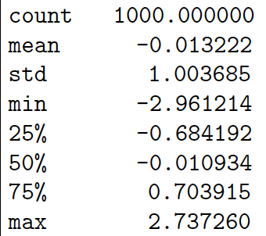
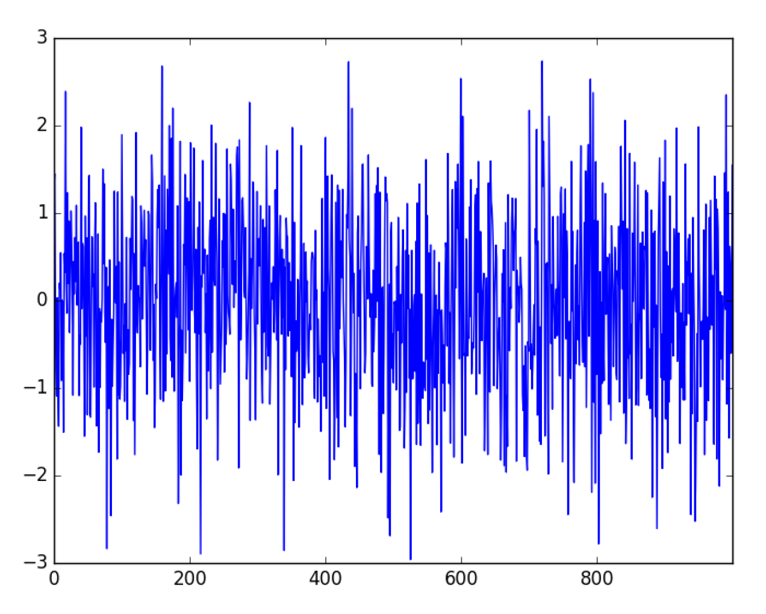
EXAMPLE White Noise
Drawing Random Numbers

Slide 12
Using and Removing Trend/Seasonality
Trends: deterministic vs. stochastic, global vs. local
Time series with trend = non-stationary
Use augmented Dickey-Fuller test to check for stationarity
Why do we care?
Removing or Adding Information to ML Model
Detrend by Differencing: value(t) = observation(t) - observation(t-1)
Detrend by Model Fitting: value(t) = observation(t) - prediction(t)

Slide 13
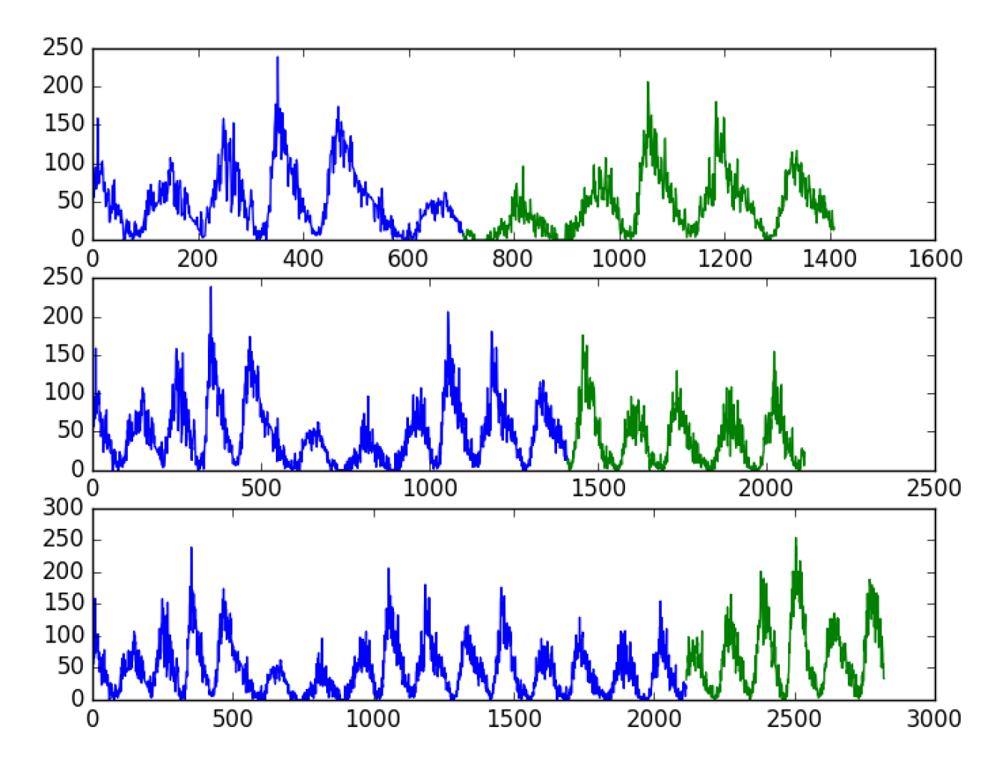
Backtest Forecast Model
Normal train-test splits or k-fold cross validations won’t work because time series data are dependent on time
Train-Test split that respect temporal order of observations.
Multiple Train-Test splits that respect temporal order of observations.
Walk-Forward Validation where a model may be updated each time step new data is received.
Example of Multiple Train-Test Split

Slide 14
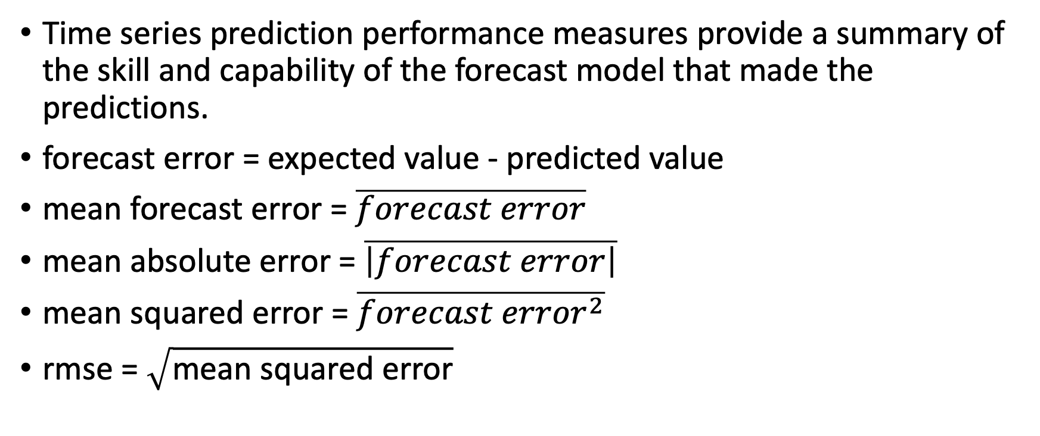
Forecasting Performance Metrics
Time series prediction performance measures provide a summary of the skill and capability of the forecast model that made the predictions.
forecast error = expected value - predicted value
mean forecast error = $\overline{forecast error}$
mean absolute error = $\overline{\left|forecast error\right|}$
mean squared error = $\overline{{forecast error}^{2}}$
rmse = $\sqrt{\text{mean} \text{squared} \text{error}}$

Slide 15
Box-Jenkins Model (ARIMA)
Autoregressive Integrated Moving Average Model
Three Steps:
Identify model that best summarizes the data
Use data to train the model
Diagnostic checking. How good is the fitted model?
Notation: ARIMA(p, q, d)
p = lag order, number of lag observations included in model
q = difference order, number of times the raw observations are differenced
d = order of moving average, size of moving average window

Slide 16

Autoregressive Models
Ex: linear regression => $x_{t+1}=b_{0}+b_{1}x_{t}+b_{2}x_{t−1}$
Models an output value based on a linear combination of input variables
Often assumes autocorrelation ($x_{t}$ is directly related to $x_{t−1}$)
Example of Lag plot
Example of autocorrelation plot

Slide 17
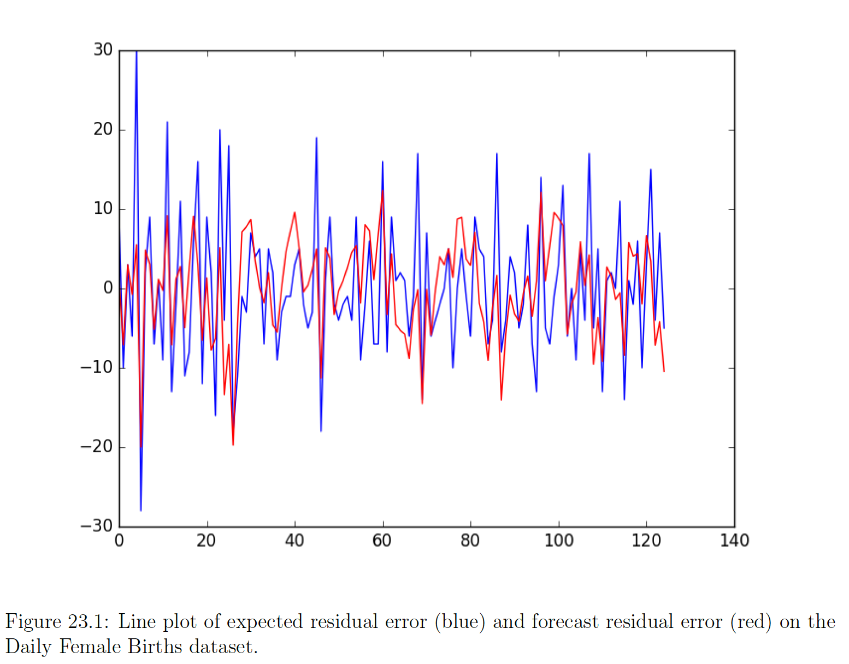

Moving Average Models
residual error = expected – predicted
Residual errors can also form a time series with trend, seasonality, …
Combine lag errors in linear regression model to get moving average model (Not to be confused with average smoothing!!)
${error}_{t+1}=b_{0}+b_{1}{error}_{t}+b_{2}{error}_{t−1}+$ ${…+b}_{n}{error}_{t−n}$
improved forecast = forecast + estimated error
Simple Way of doing this:
1. Calculate the persistence prediction (t+1 = t).
2. Predict the residual error using the autoregression model.

Slide 18
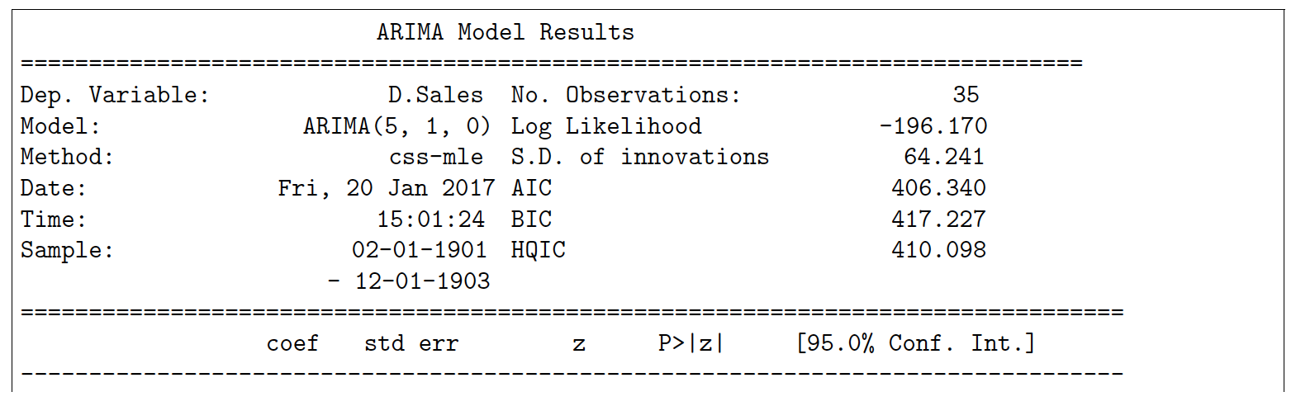
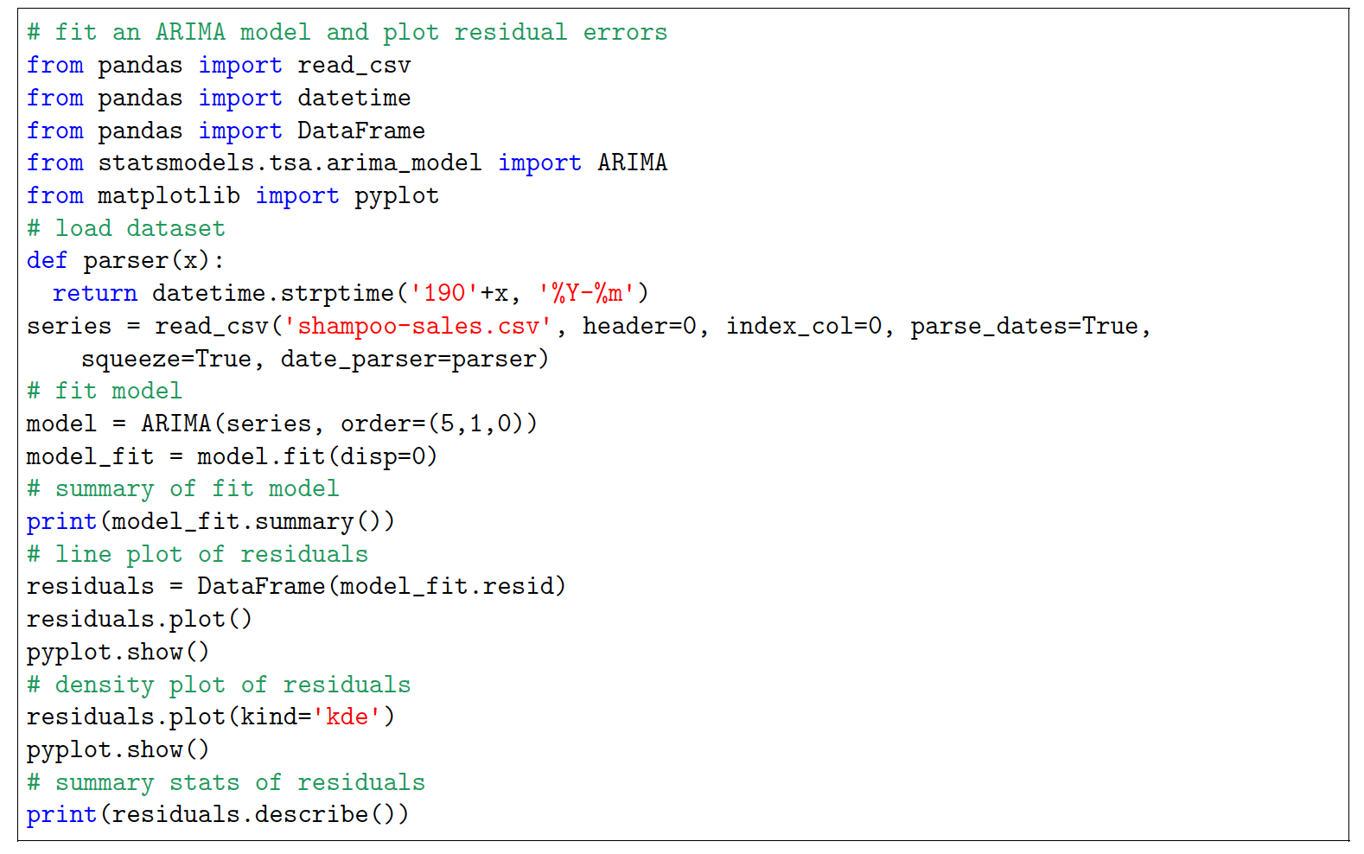
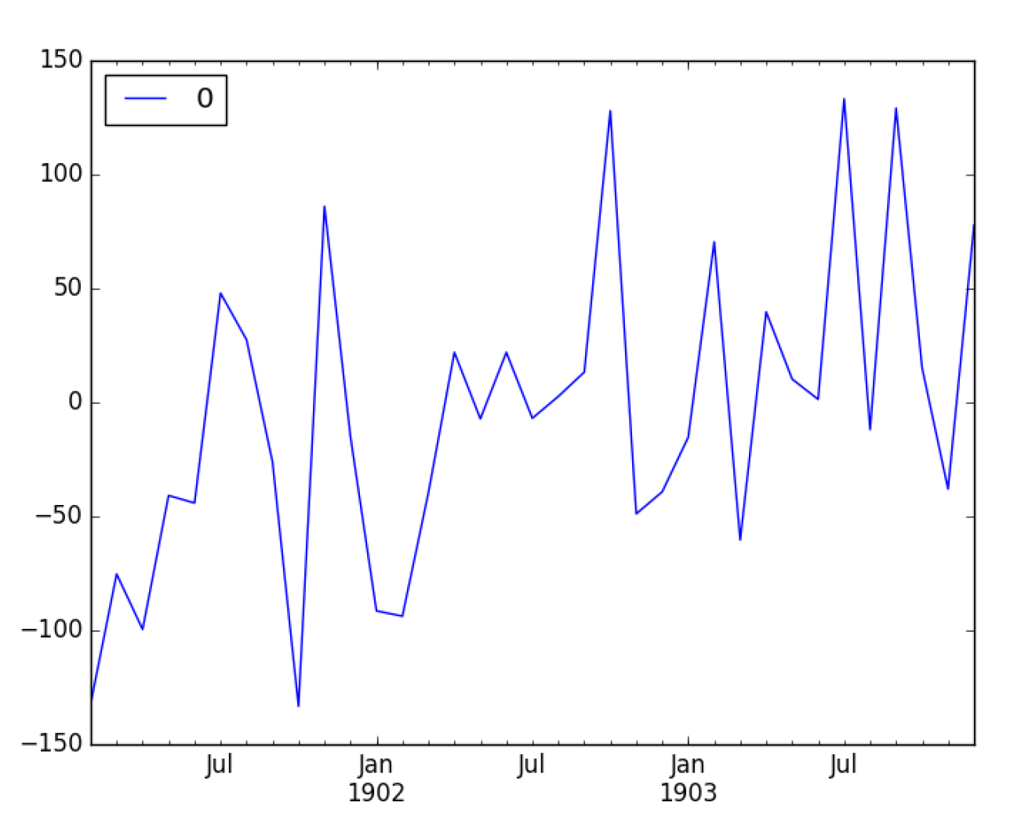
ARIMA with Python
Fitting an ARIMA model to a time series data set

Slide 19
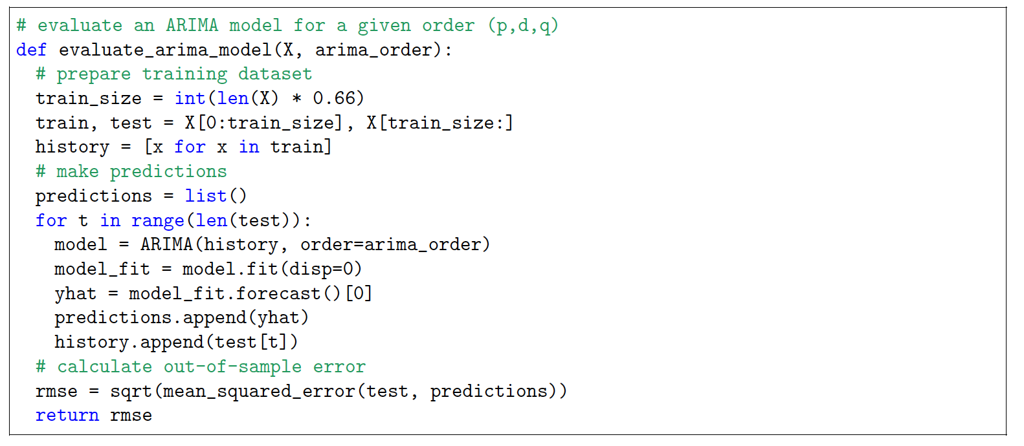
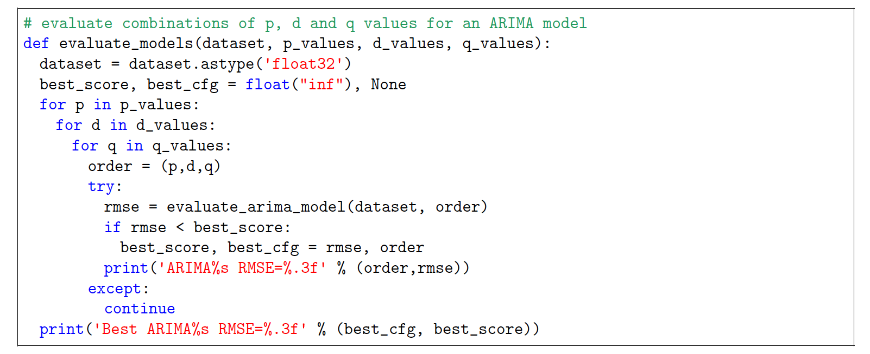
Grid Search Arima
How to configure the three ARIMA parameters (p, d, q)?
Two Steps:
1. Evaluate an ARIMA model. (find error score)
2. Evaluate sets of ARIMA parameters.
1. Evaluate Model
2. Evaluate ARIMA Parameters

Slide 20
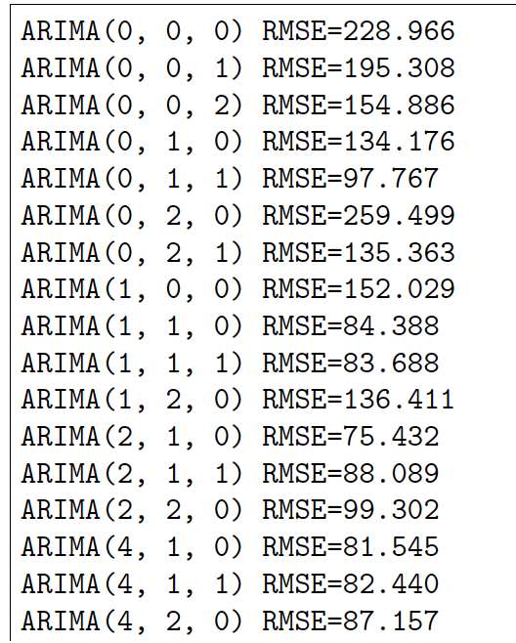
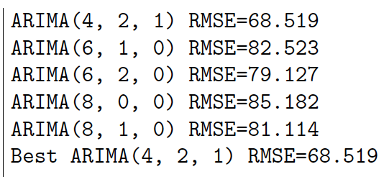
Results:

Slide 21
Resources:
https://machinelearningmastery.com/about/
https://scholar.google.com/citations?user=hVaJhRYAAAAJ&hl=en
https://superfastpython.com/
https://www.youtube.com/watch?v=Aw77aMLj9uM

